Slide 1

A PROJECT ON DEVELOPING
EXPOSYS
MASS MAIL DISPATCHER

Slide 2
STUDENT NAME: NANDINI KAPURCHAND RATHOD COLLAGE NAME: JAIN UNIVERSITY, BENGALURU UNDER THE GUIDANCE: EXPOSYS DATA LABS BENGALURU

Slide 3
CONTENTS
ABSTRACT
INTRODUCTION
OBJECTIVE
PROJECT METHOD WITH ARCHITECTURE
DETAILS OF THE PROJECT
CONCLUSION

Slide 4
ABSTRACT Mass-Mail Dispatcher makes the procedure of mass mailing quick and simple. Many people are first exposed to code through web development, yet little is known about the barriers beginners face in these formative experiences. In this article, we describe a study of undergraduate students enrolled in an introductory web development course taken by both computing majors and general education students.

Slide 5

INTRODUCTION
A bulk email is a marketing message sent by a brand to multiple recipients at once. It aim to promote a business, sell goods, and develop relationships. We can use CSV file formats which can contain bulk E-mail address and checks if given any E-mail is valid or invalid.

Slide 6
OBJECTIVE
The objective of a bulk email dispatcher is to efficiently and effectively send a large volume of emails to a targeted audience in a timely manner. The primary goal is to facilitate communication, marketing, or information dissemination to a wide group of recipients simultaneously

Slide 7
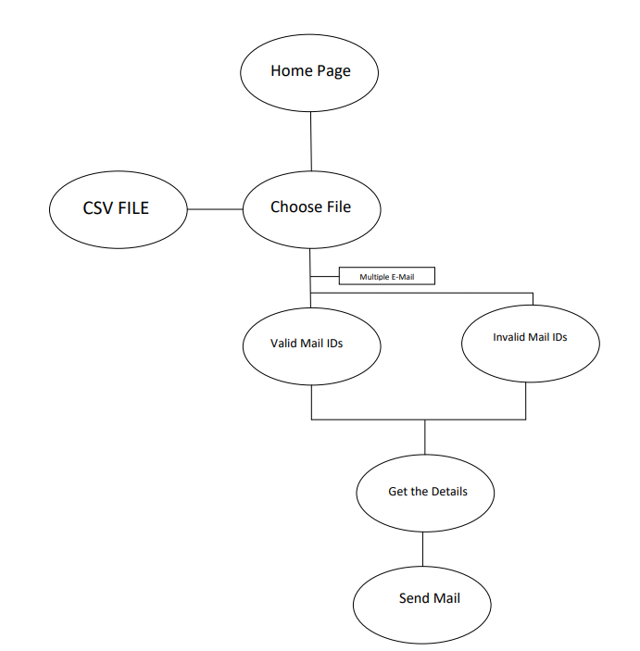
PROPOSED METHOD WITH ARCHITECTURE

Slide 8
DETAILS OF THE PROJECT
This is a Mass Mail Dispatcher where we send bulk mail to set of people at once. In dispatcher we can use CSV file formats which can contain bulk E-mail Address and checks if given any Email is valid or invalid.

Slide 9
CONCULSION
Becoming a web developer is more than just working in the browser. Web developers write applications, and you are on that path. I encourage you to continue learning HTML, JavaScript, CSS, and Python. But when you're comfortable, branch out to other languages and platforms. The more exposure and experience you have with other languages and platforms, the better you'll become as a developer.

Slide 10
THANK-YOU
NANDINI KAPURCHAND RAHTOD

